Slide 1


Line following – Obstacle detection and Collision prevention Robot
AMIT diploma graduation project (Group D75-ONLINE)

Slide 2
Project description:
Utilizing the ATmega32A microcontroller.
Line following using the TCRT5000 sensor modules (3x) by reading the reflection and taking the digital voltage output values.
Obstacle detection using the ultrasonic sensor HC-SR04, which is positioned above a servo motor axis that scans left & right to determine if there is no obstacle right or left to continue moving then go back and follow the line.
All of this is built on a Robot car chassis (4WD) utilizing 2x L293D H-bridge motor ICs.
LCD display shows the current direction taken and warns if an obstacle is detected.

Slide 3
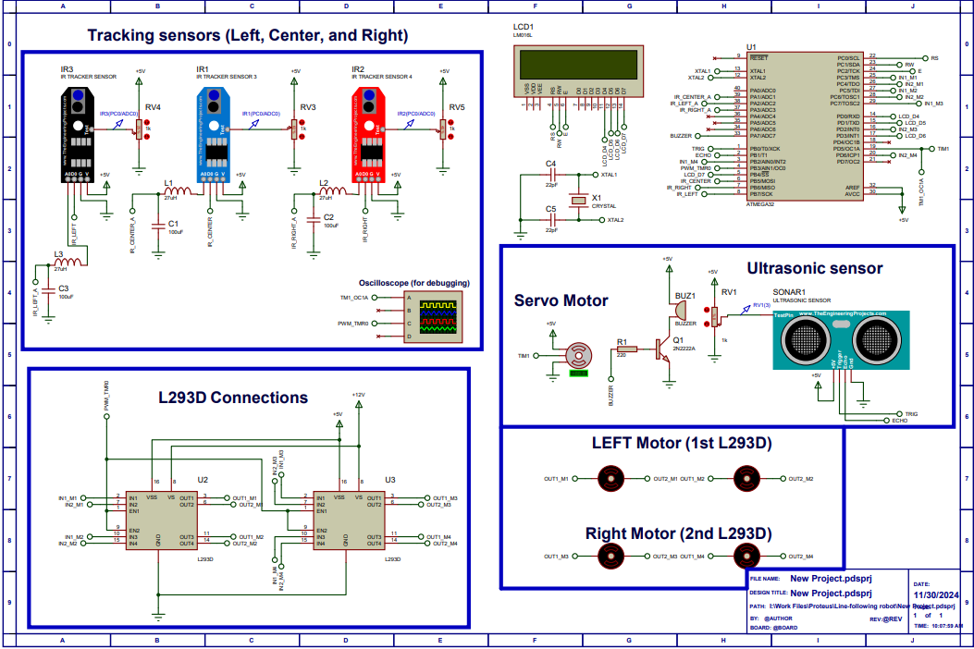
Proteus Simulation:
The circuit is fully simulated using proteus software.

Slide 4
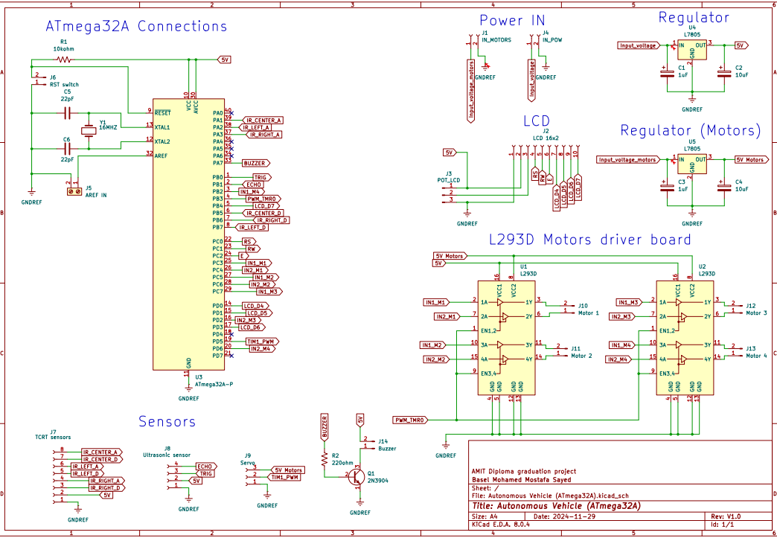
Project connections and Schematic:
I’ve made an exact connections schematic/diagram showing the components/ICs required so the project is easy for everyone to follow along if they so wish.
Using Ki-CAD software.

Slide 5
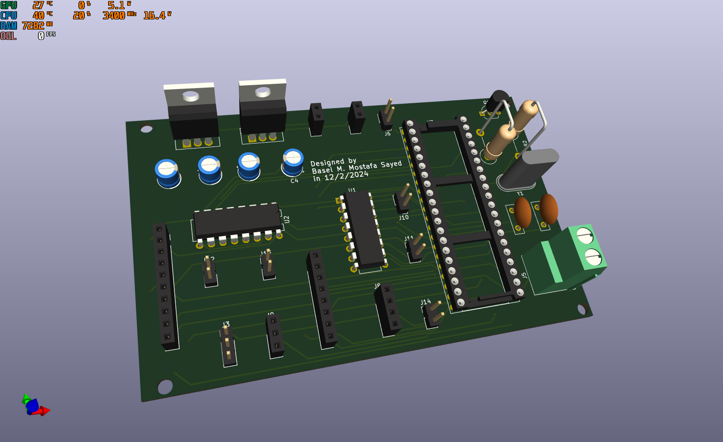
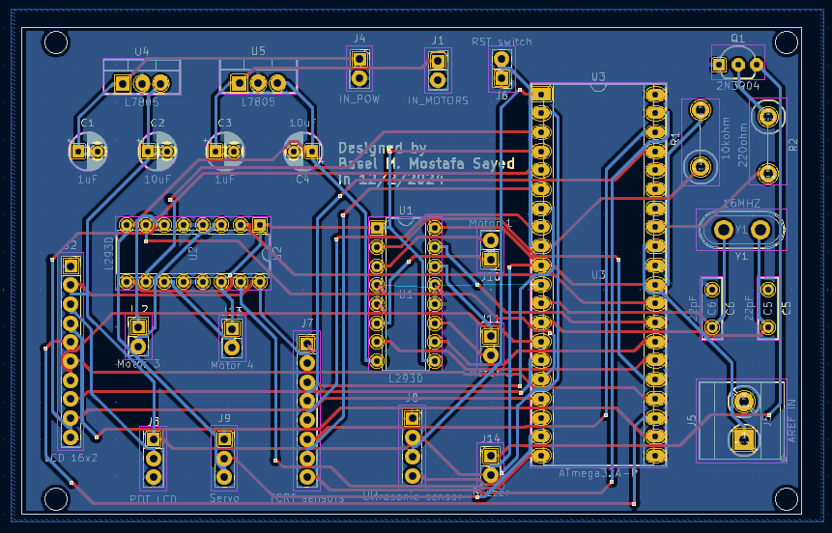
PCB designed and ready for printing
3D Model of PCB:
PCB design in Ki-CAD:

Slide 6
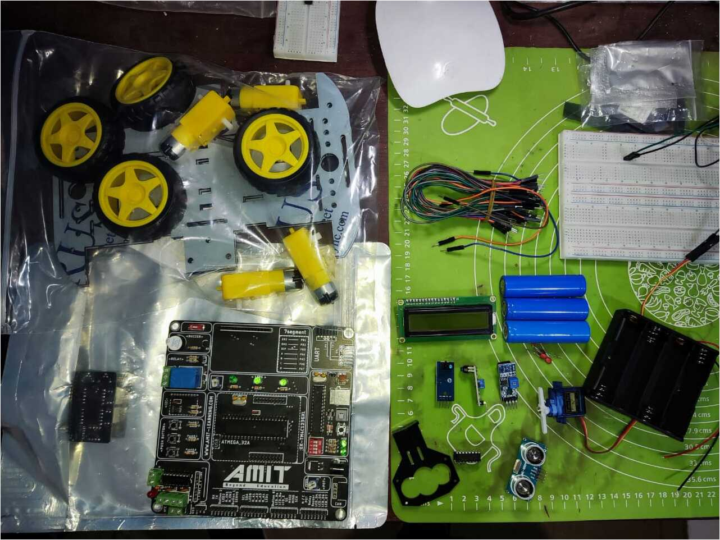
Components Needed:
1x ATmega32A MCU
2x 22pF Ceramic capacitor
1x 16MHZ crystal
2x L293D Motor driver ICs
1x LM7805 5v regulators
1x Robot car chassis with 4 motors
1x Ultrasonic sensor (HC-SR04)
1x Servo (SG-90)
3x TCRT5000 sensor modules
1x LCD 16x2 display

Slide 7
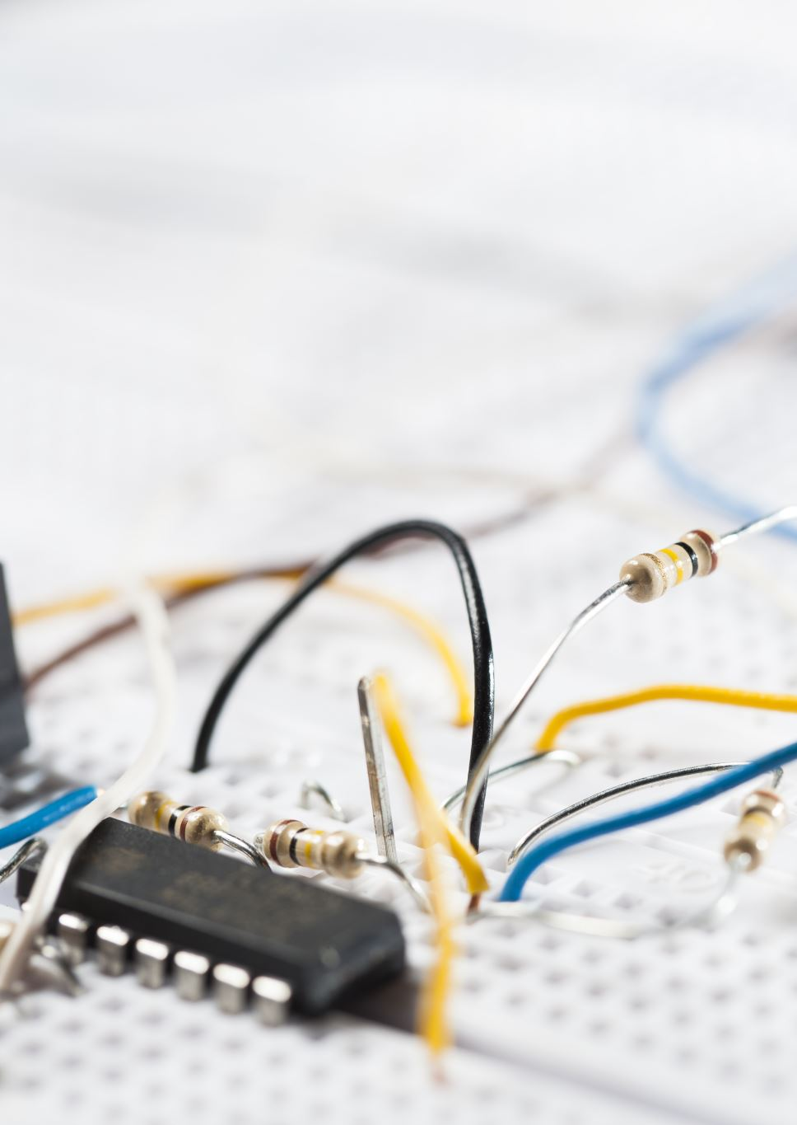
How it works:
MCU constantly reads the ultrasonic sensor’s distance and depending on the received response, the MCU activated one of two functions.
1) Moving normally forward: The MCU checks the digital state of pins connected to the Three TCRT sensors and depending on them, there are conditions that activate accordingly to follow the line.
2) Obstacle Avoidance mode: Which when activated displays a warning on screen with a Buzzer sounding off as an alarm to warn the surrounding, when the obstacle is no longer present, then the Vehicle goes back to Line following mode.

Slide 8
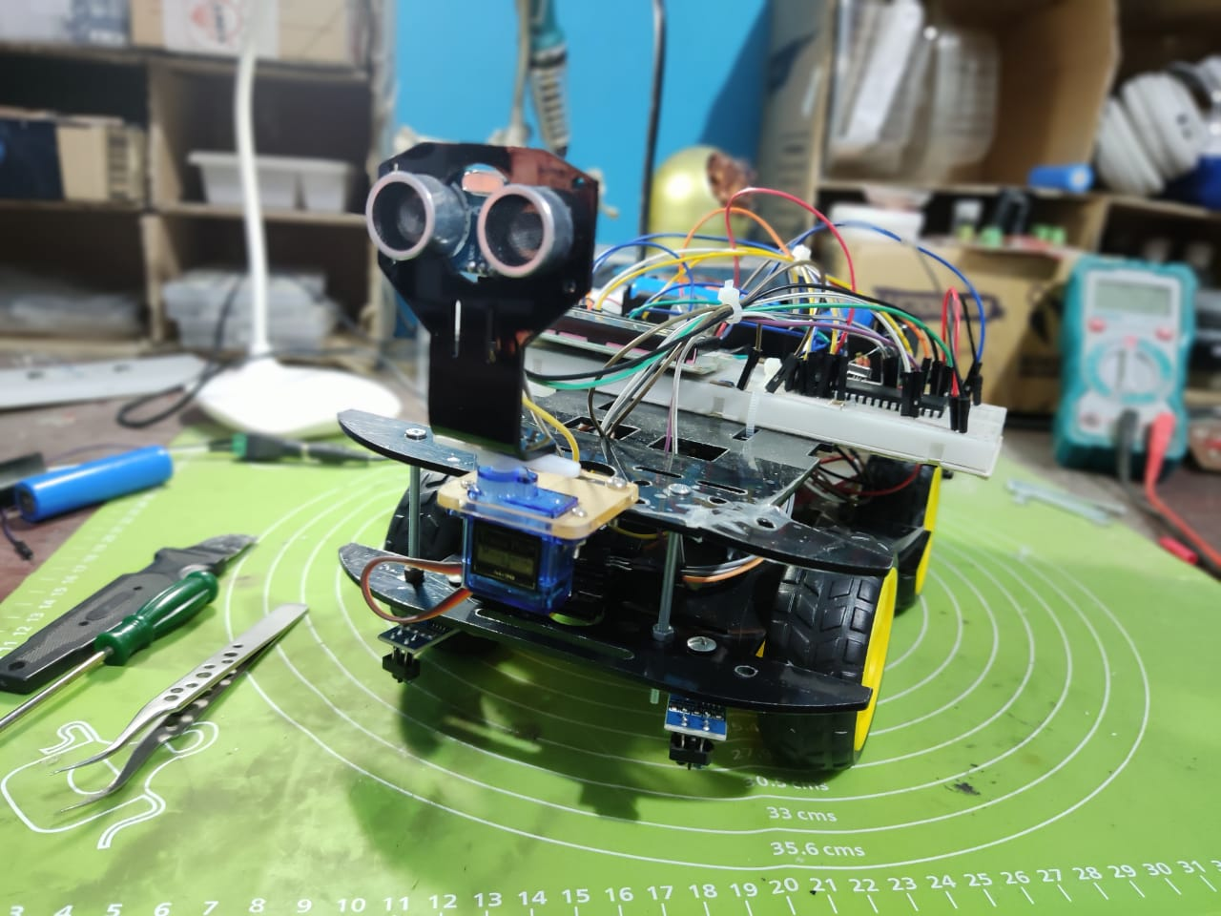
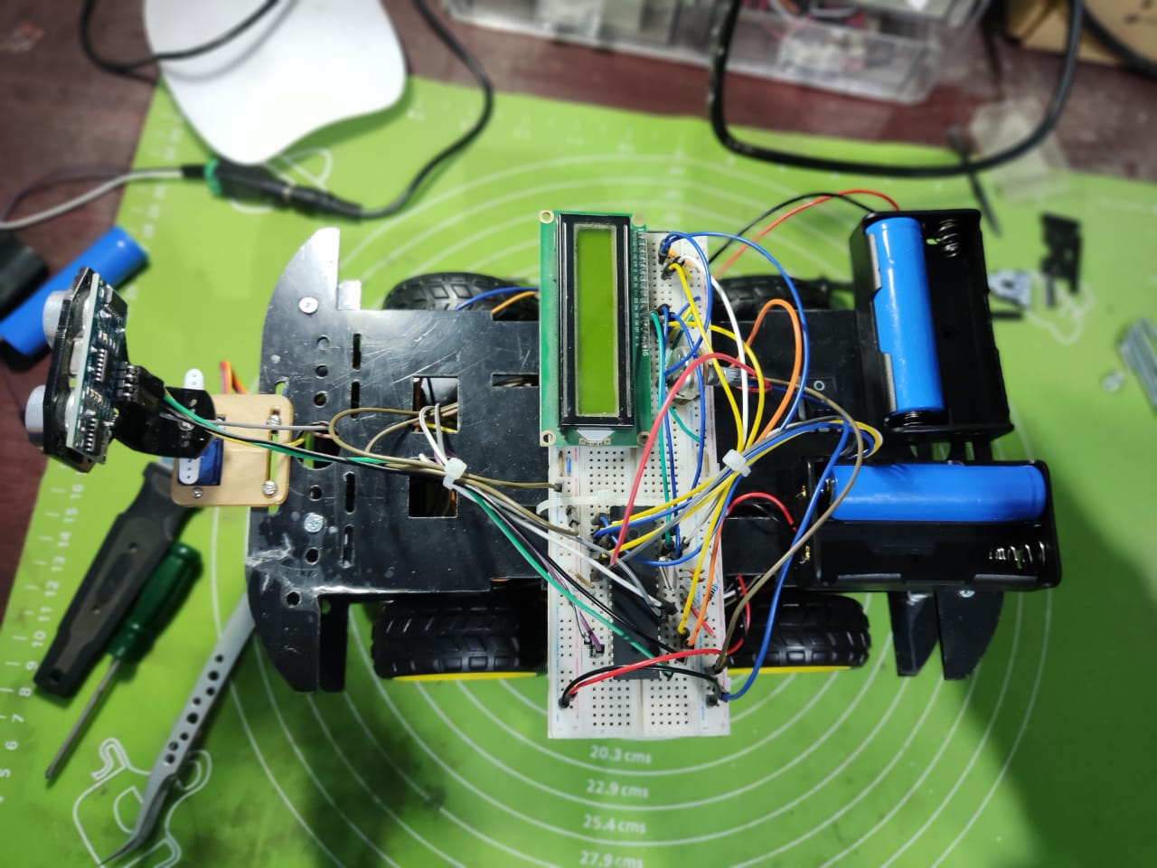
Pictures:

Slide 9
Information
Name: Basel Mohamed Mostafa Sayed
Group number: D75-online
Email: baselmohamed802@gmail.com
LinkedIn Profile: www.linkedin.com/in/basel-sayed-b11534243

